Slide 1
Weekly meeting
6 6 2024
Ty Bottorff

Slide 2
Outline
SI debrief, brief progress on new steps

Slide 3
DP CD127⁺ vs. other DP (are DP CD127⁺ actually T_{ex}?) DP CD127⁺ vs. non-exhausted CD127⁺

Slide 4
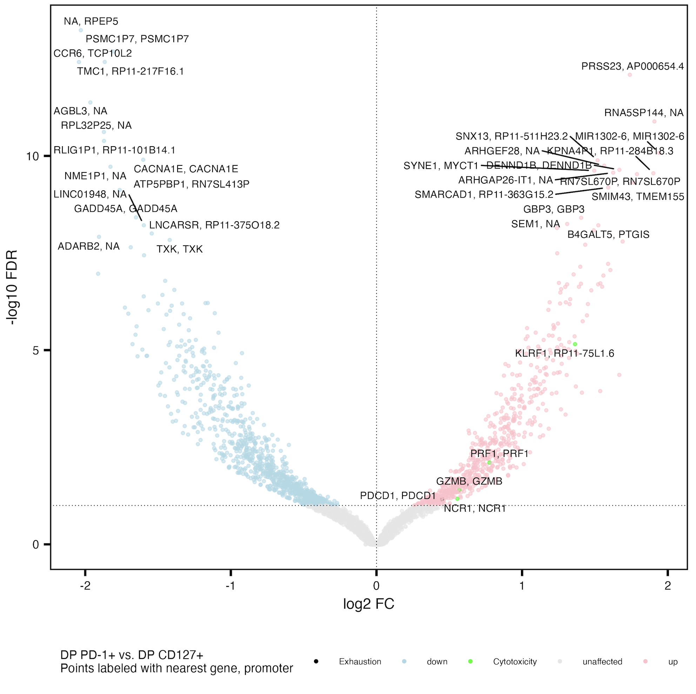
Cytotoxicity peaks’ genes and PD-1 peaks more accessible in DP PD-1⁺ vs. DP CD127⁺
Exhaustion: CD244, SLAMF6, TBX21, PDCD1, HAVCR2, KLRG1, TOX, TCF1, PD1, CTLA4, LAG3, TIM3, TIGIT, KIR3DL2, KIR2DL3, NKG2A
Cytotoxicity: GZMA, GZMB, GZMH, GZMM, GZMK, PRF1, NCR1, KLRF1, NKG7

Slide 5
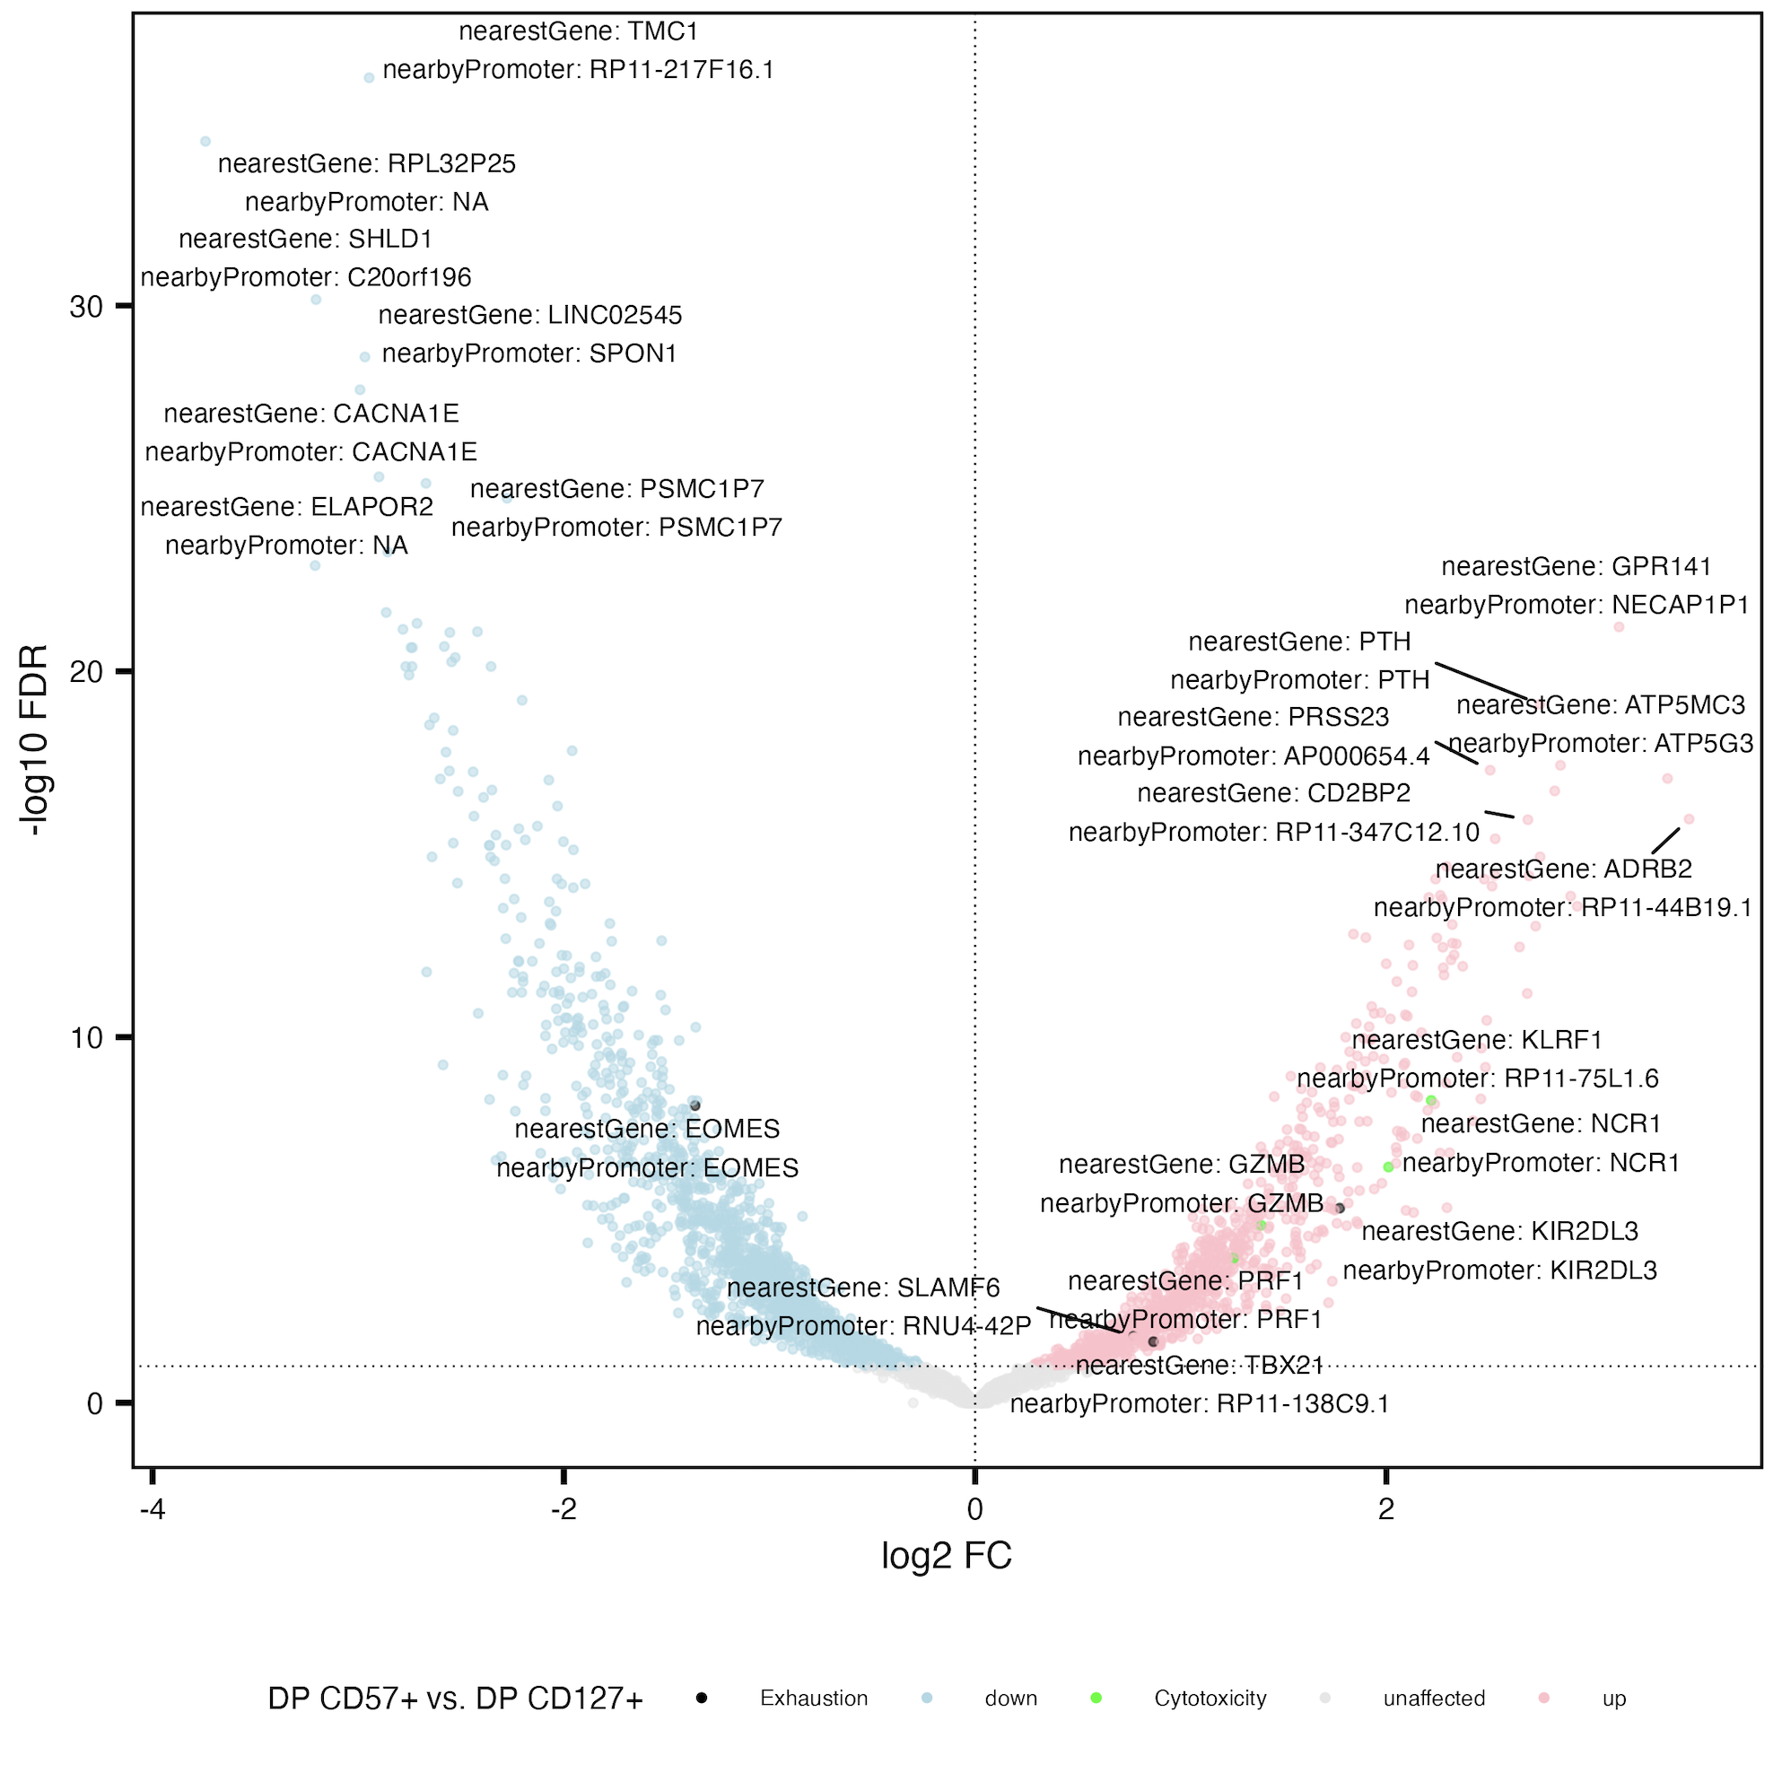
Cytotoxicity peaks’ genes and TBX21 peaks more accessible in DP CD57⁺ vs. DP CD127⁺
Exhaustion: CD244, SLAMF6, TBX21, PDCD1, HAVCR2, KLRG1, TOX, TCF1, PD1, CTLA4, LAG3, TIM3, TIGIT, KIR3DL2, KIR2DL3, NKG2A
Cytotoxicity: GZMA, GZMB, GZMH, GZMM, GZMK, PRF1, NCR1, KLRF1, NKG7
Notes:
EOMES down in CD57 (vs. DN, vs. DP PD-1+, vs. DP CD127+)

Slide 6
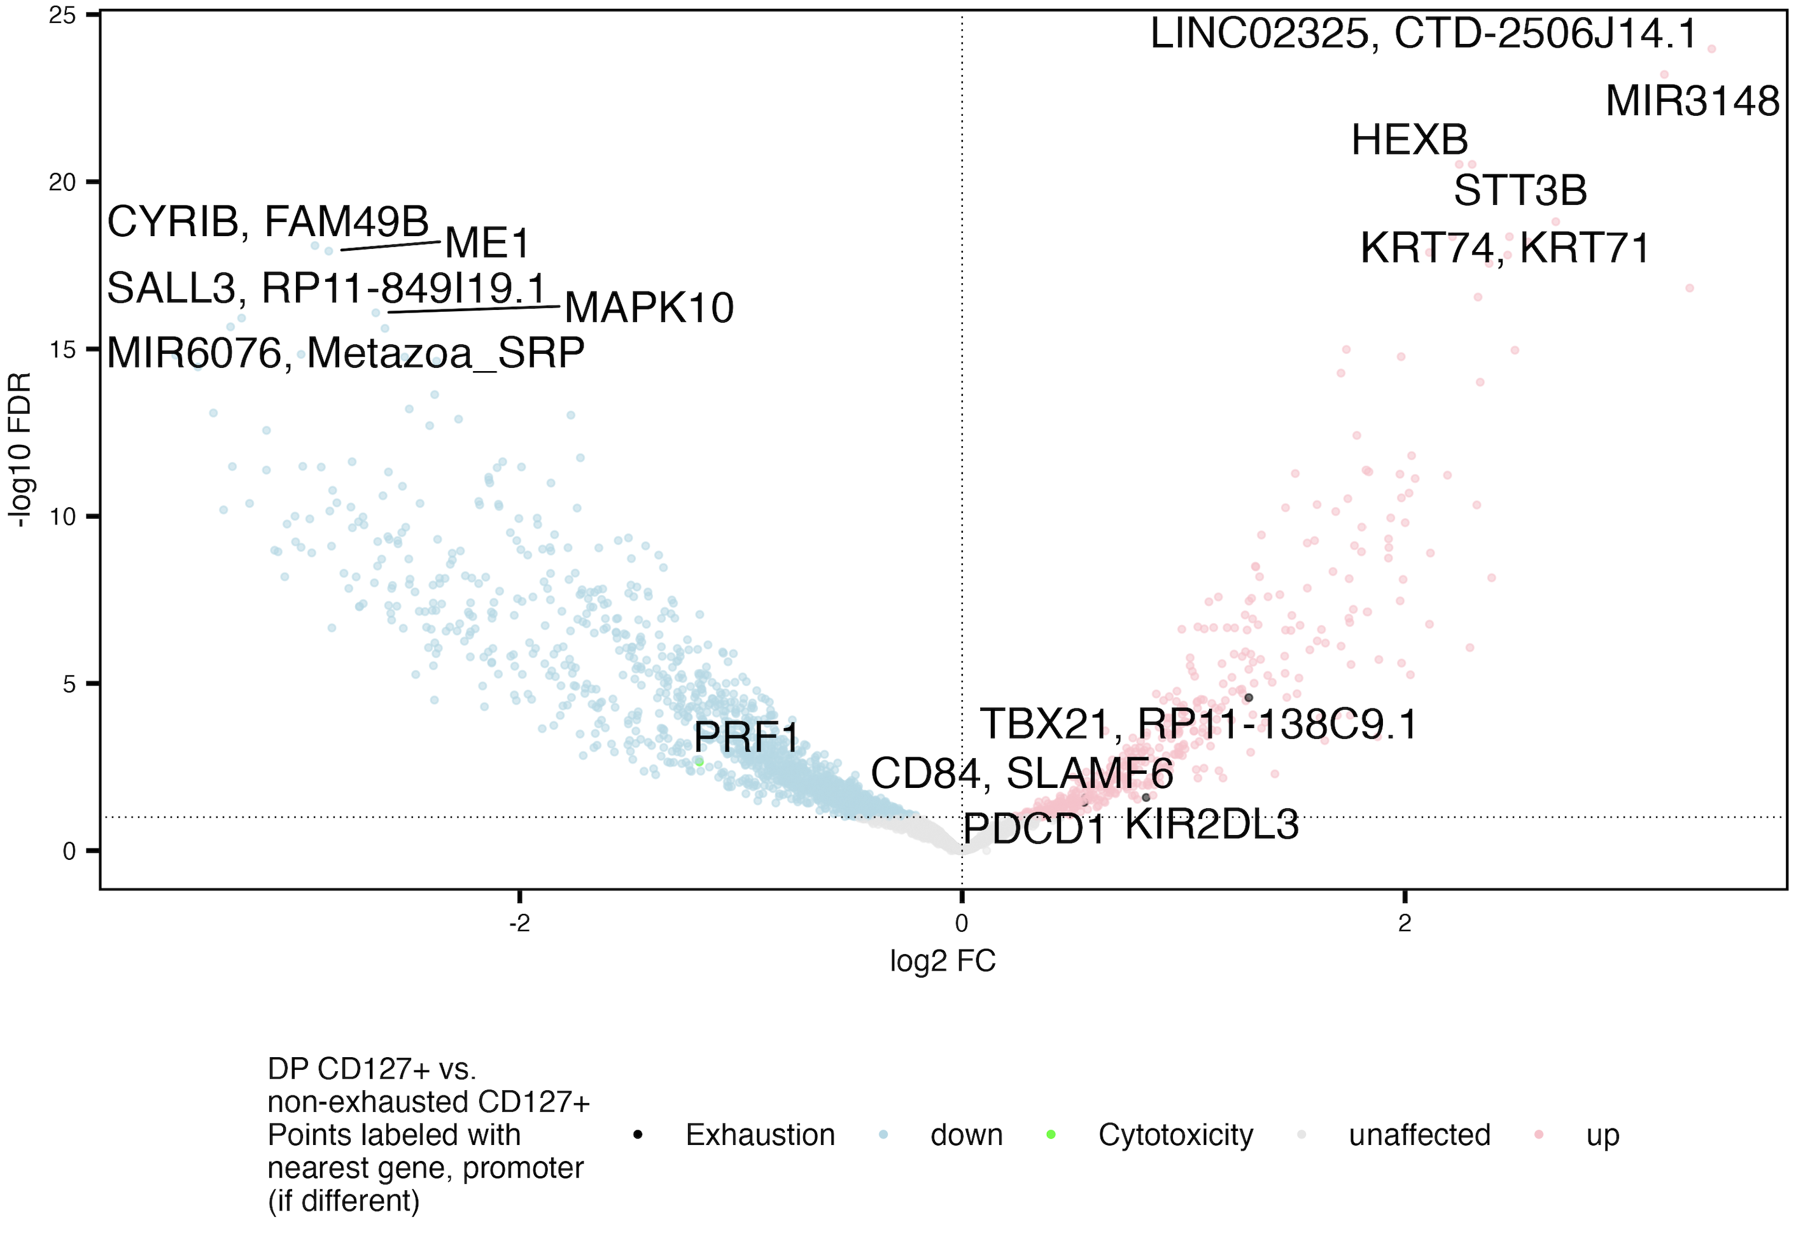
Exhaustion peaks’ genes more accessible, PRF1 peaks less accessible in DP CD127⁺ vs. non-exhausted CD127⁺
Exhaustion: CD244, SLAMF6, TBX21, PDCD1, HAVCR2, KLRG1, TOX, TCF1, PD1, CTLA4, LAG3, TIM3, TIGIT, KIR3DL2, KIR2DL3, NKG2A
Cytotoxicity: GZMA, GZMB, GZMH, GZMM, GZMK, PRF1, NCR1, KLRF1, NKG7
Notes:
KIR2DL3 peak more accessible here in DP CD127⁺ is consistent with DP CD127⁺ being more similar to DP CD57+ than non-exhausted CD127⁺

Slide 7
Conclusions from this section
DP CD127⁺ vs. other DP (are DP CD127⁺ actually T_{ex}?)
perhaps DP CD127⁺ is more T_{ex} (less cytotoxic) than other DPs
DP CD127⁺ vs. non-exhausted CD127⁺
DP CD127⁺ more T_{ex}, less T_{eff} (cytotoxic) than non-exhausted CD127⁺
Data not shown: ~no results from…
shared up peaks’ genes in DP PD-1⁺/DP CD57⁺ vs. DN (not up in DP CD127⁺ vs. DN)
unique up peaks’ genes in DP CD127⁺ vs. DN
shared up peaks’ genes in DP CD127⁺ vs. both other DPs (PD-1⁺ and CD57⁺), did see IL7R)
TODO: check at promoter rather than gene level…

Slide 8
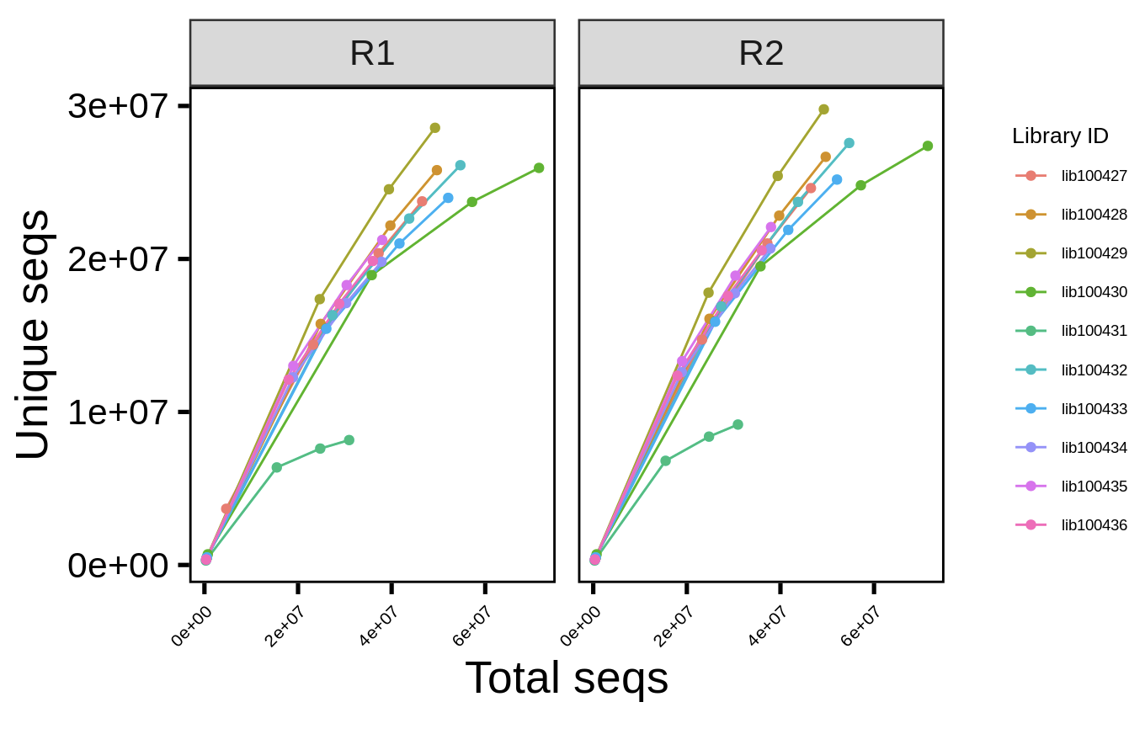
Most tested libraries could likely benefit from additional sequencing
only ~20% of libraries tested here (computational limits)
TODO: compare Erin’s Homer results pre/post read count downsampling

Slide 9
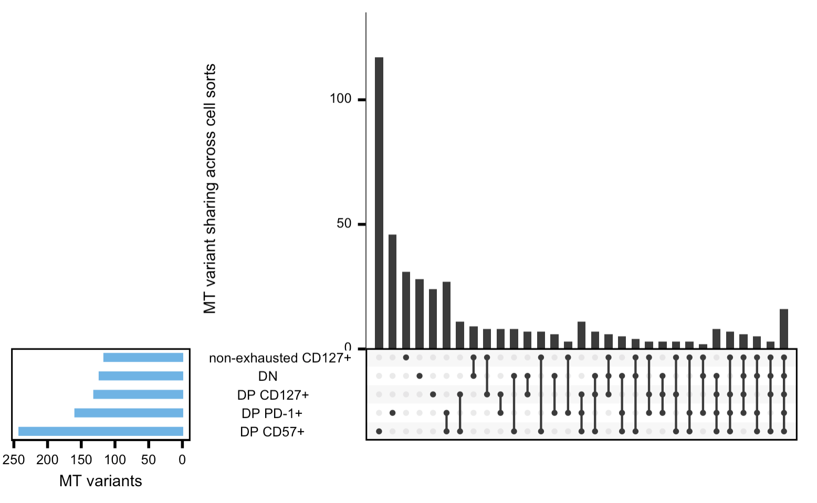
DP PD-1⁺ and DP CD57⁺ share the most MT variants out of any double overlap! The 3 DPs share the most out of any triple overlap
Methods (followed Xu et al. (2019), eLife)
Extract MT mapping reads
Create pileup files (necessary input for Varscan)
Run Varscan variant caller on each library
Filter out possible seq/mapping errors
Looked for MT variant (most frequent var) overlaps within each donor, sum across donors
TODO: observed vs. expected? ~difficult with 5 sets
Notes:
Ran into issues with mgatk tool (Lareau et al. (2021), Nat Biotechnol)

Slide 10
More high priority next steps for P576 from SI
Paired analyses: compare differences within vs. between individuals?
Heatmap of peaks’ accessibilities by cell sort
Adjust for donor and responder status effects when comparing cell sorts
~in progress
R vs. NR DARs
More accessible in R
FBA1
MIR1184-1
More accessible in NR:
C10orf71
PPIAP68
AC007679.3
C10orf128
MIR4279
DISC-1
BTBD16: SNPs near this gene associated with time to T1D (Sharma et al. (2018), J. Autoimmun.)
RNU6-728P
Notes:
Want to clarify what point 1 means (Alice W.’s Q that confused me at SI)…

Slide 11
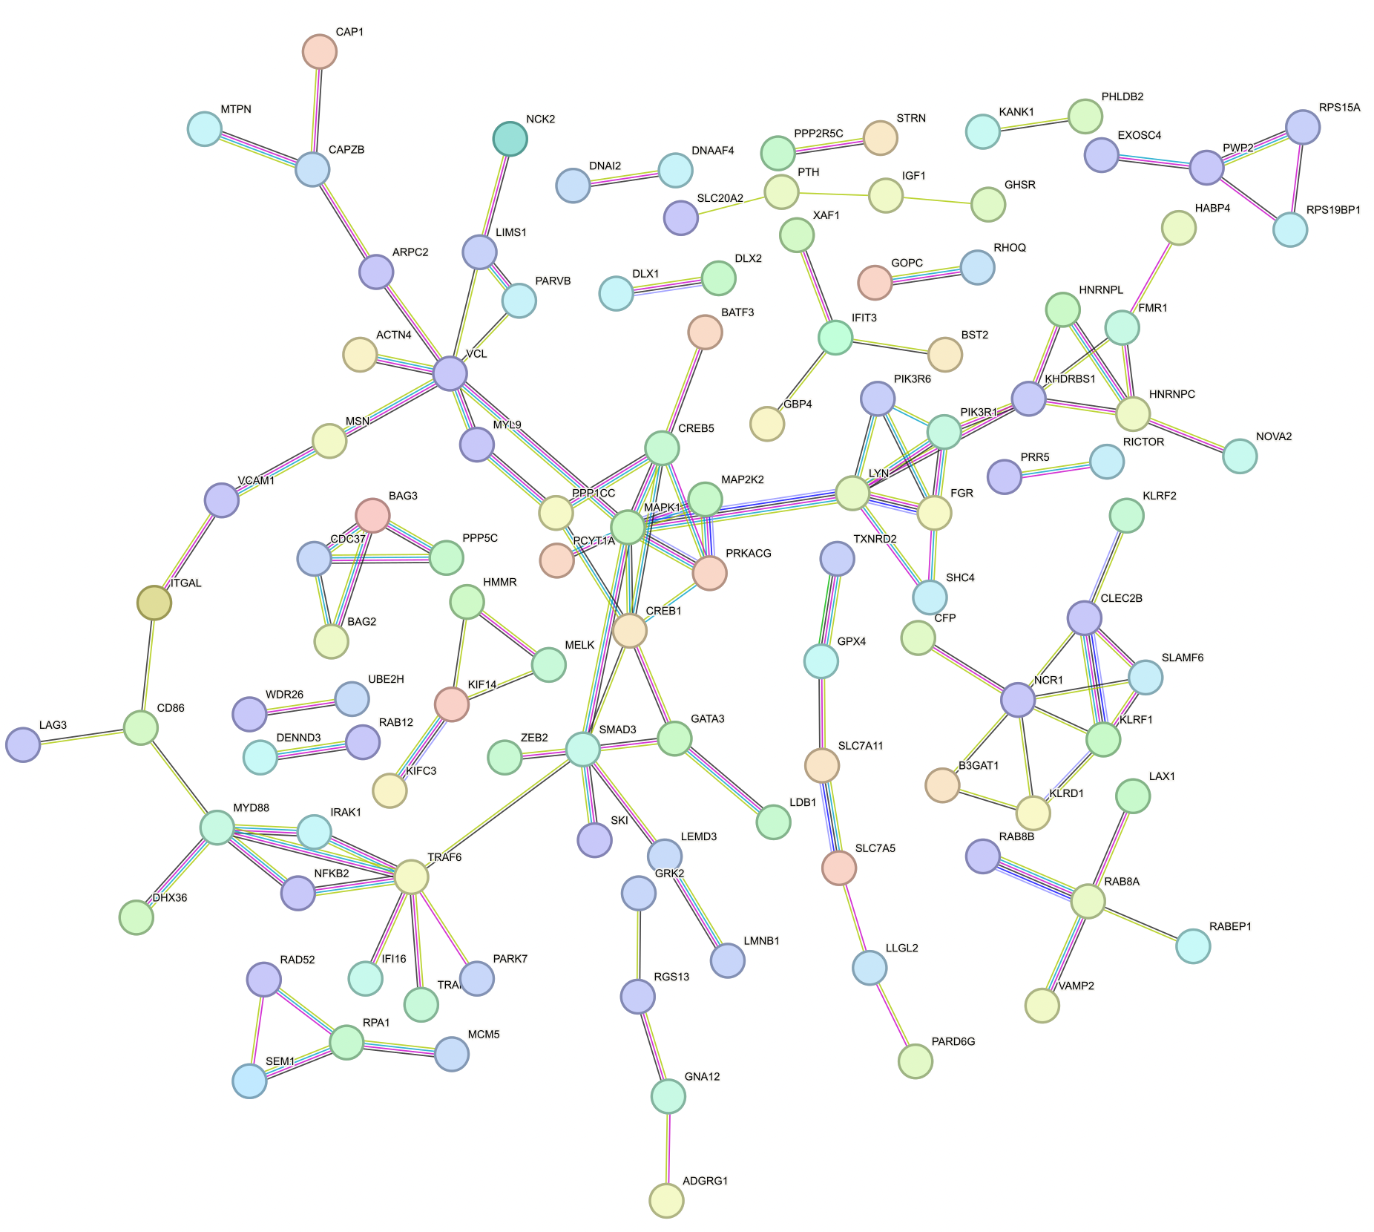
DP PD-1⁺/DP CD57⁺ shared up peaks’ genes vs. DN not up in DP CD127⁺ vs. DN
Notes:
MAPK1: signaling (MAPK)
PIK3Rs are regulatory subunits of PI3K
Phosphatidylinositol 3-kinase (PI3K) plays an important role in the metabolic actions of insulin, and a mutation in this gene has been associated with insulin resistance
IFIT = IFN induced?
BAG proteins compete with Hip for binding to the Hsc70/Hsp70 ATPase domain and promote substrate release

Slide 12
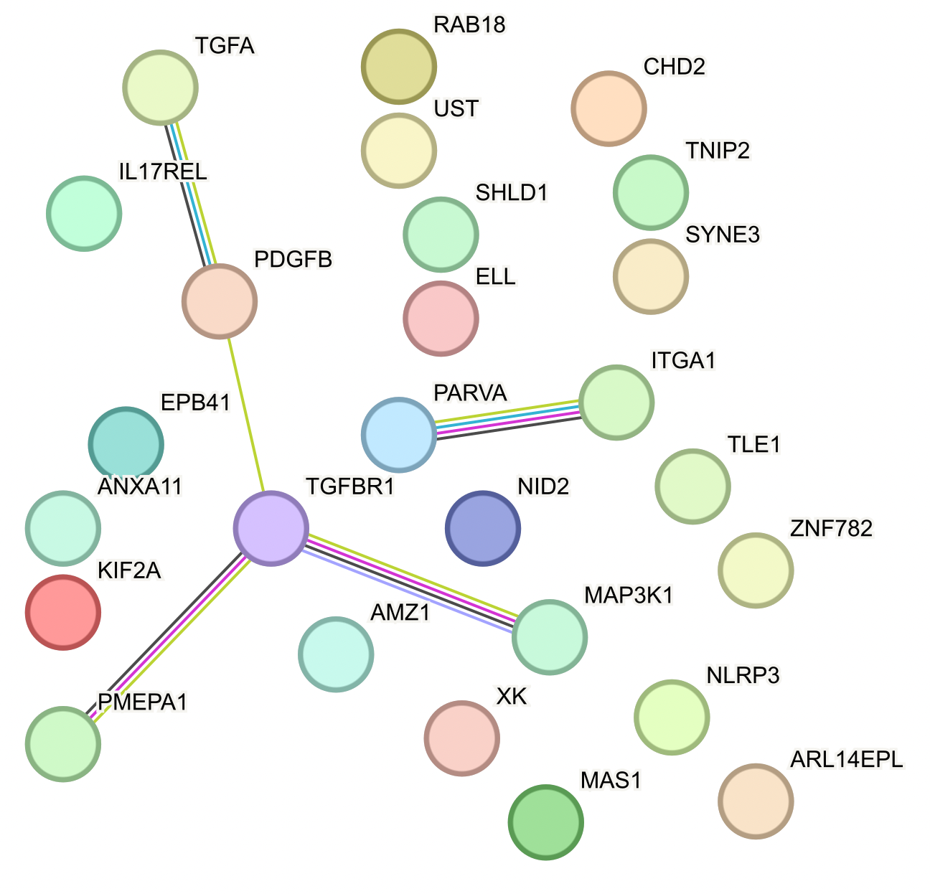
DP CD127⁺ unique up peaks’ genes vs. DN
Notes:
TGF beta immunosuppressive
TGFB signaling
PDGF = platelet derived growth factor
ITGA1 = integrin subunit

Slide 13
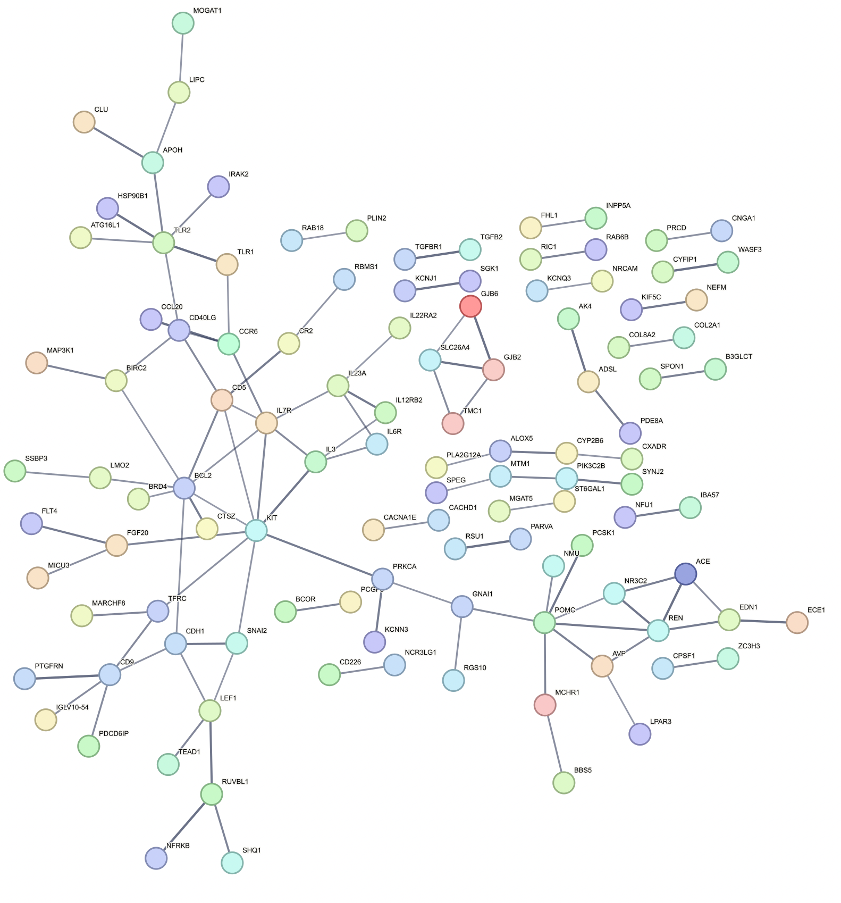
More accessible peaks’ genes in DP CD127⁺ vs. both other DPs (PD-1⁺ and CD57⁺)
- IL7R (expected)
- TLR1/2
Notes:
LEF1: transcription factor belonging to a family of proteins that share homology with the high mobility group protein-1. The protein encoded by this gene can bind to a functionally important site in the T-cell receptor-alpha enhancer, thereby conferring maximal enhancer activity

